Slide 1
BIKE SHARE CUSTOMER ANALYSIS
ANIL RAJU

Slide 2
OBJECTIVE
Analyze the historical bike trips data to identify trends between annual members and casual riders to understand how they use cyclistic bikes differently.

Slide 3
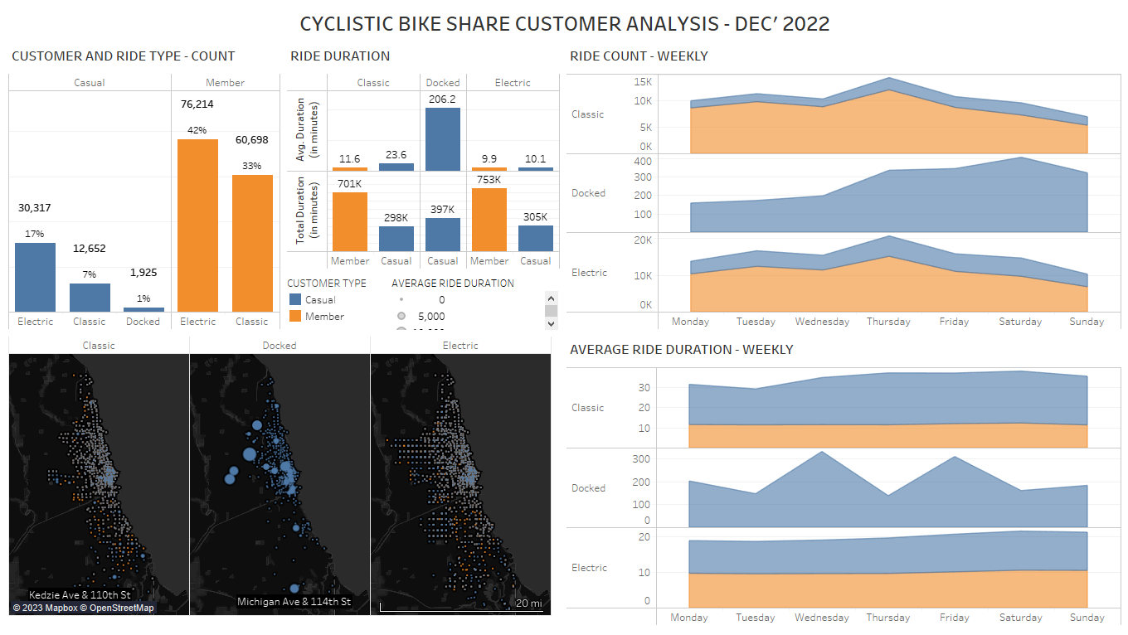

Slide 4
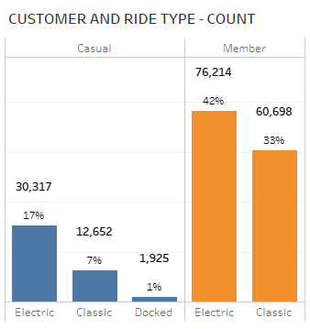

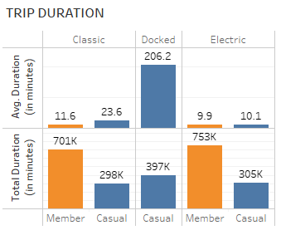
About 25% of the trips are initiated by the casual customers, displaying a potential for growth in memberships.
Note that only the casual customers had used the docked bikes.
Although the number of trips and the total trip duration by casual customers are lower than members in every ride type, the average trip duration per customer is higher for casual riders.
Note that the average trip duration per customer is higher for casual riders using classic and docked bikes.

Slide 5
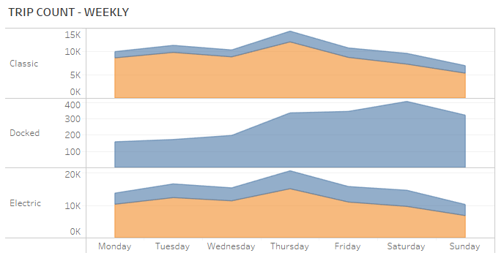
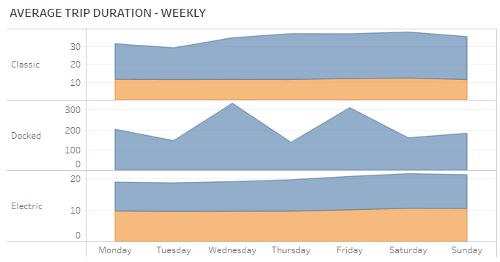
The area plot shows weekly distribution of the total trip count on the top and the average trip duration in the bottom and categorized by the three ride types.
We don’t observe any deviating trend in the trip count between the casual and member customers across the week in all the ride types.
We do observe a spike in the average trip duration from casual customers of classic bikes from Wednesday and this lasts till the Saturday of the week. We don’t see any similar spike among the member customers.

Slide 6
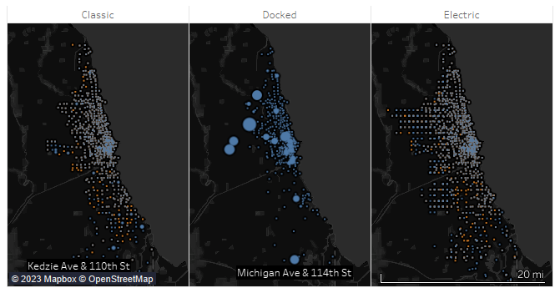

North
West
The above map shows the trip start locations, the width of the circle shows the average trip duration for casual customers in blue and members in orange around Chicago and it suburbs for the three ride types side by side.
Note that all the three ride types are used for longer duration by the casual customers around the main city of Chicago. There are more customers around it’s northern and western suburbs whereas member customers are widely spread out around the city and it’s suburbs.
Notes:
The classic bikes are majorly used for longer durations by casual customers near the main city of Chicago, whereas member users are randomly spread out.
The docked users are majorly located in the main city of Chicago and towards it’s north and east suburbs and a few in the south.
Electric casual customers are more densely populated around the main city and it’s northern suburb, whereas the member customers are randomly spread out.

Slide 7
COMPARISON – CUSTOMER TYPES
MEMBER CUSTOMERS | CASUAL CUSTOMERS
No docked bike users | Every docked bike user is a casual user
Average duration of trips for classic bikes are about 11.6 minutes | Average duration of trips for classic bikes is 100% more than the members
Consistent usage across the week | The duration of trips on classic bikes spikes up on Wednesday and continues till Saturday.
Trip starting points are spread out randomly among the city and suburbs | Trip start points are majorly concentrated around the city and the north/west suburbs of the city

Slide 8
THANK YOU

